Slide 1

PRESENTATION SLIDES
By KP-20-309A
12S17006 Tripheni H Simanjuntak
12S17023 Jessycha R Tampubolon
12S17056 Maria A Manullang

Slide 2

Introduction

Slide 3
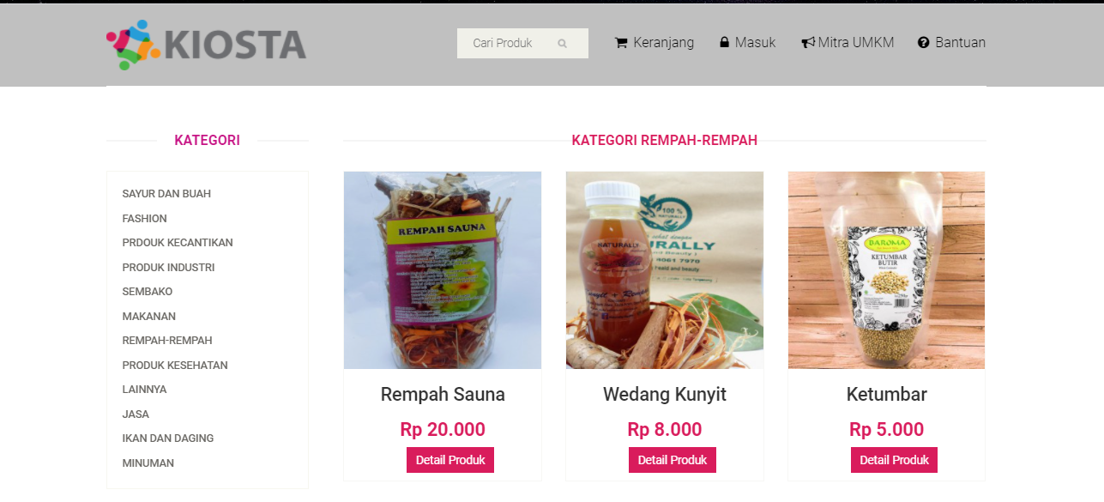
KIOSTA is a UMKM Go Digital Platform Marketplace useful for promoting Indonesian UMKM to be known many people. This platform provides online buying and selling transaction focusing on selling UMKM’s Product.

Slide 4



ACCOUNT authentication
BROWSE PRODUCT DATA
BROWSE THE BANTUAN
Functions used by customers, UMKM partners and admin to validate the identity when he wants access the system.
Functions used by visitors, customers and UMKM partners to provide functionality for users to see a list of products and services that the party offers UMKM partners.
Functions used by visitors, customers and UMKM partners can be used by users to view information about how to register, how to shop, payment, delivery and terms and conditions.

Slide 5
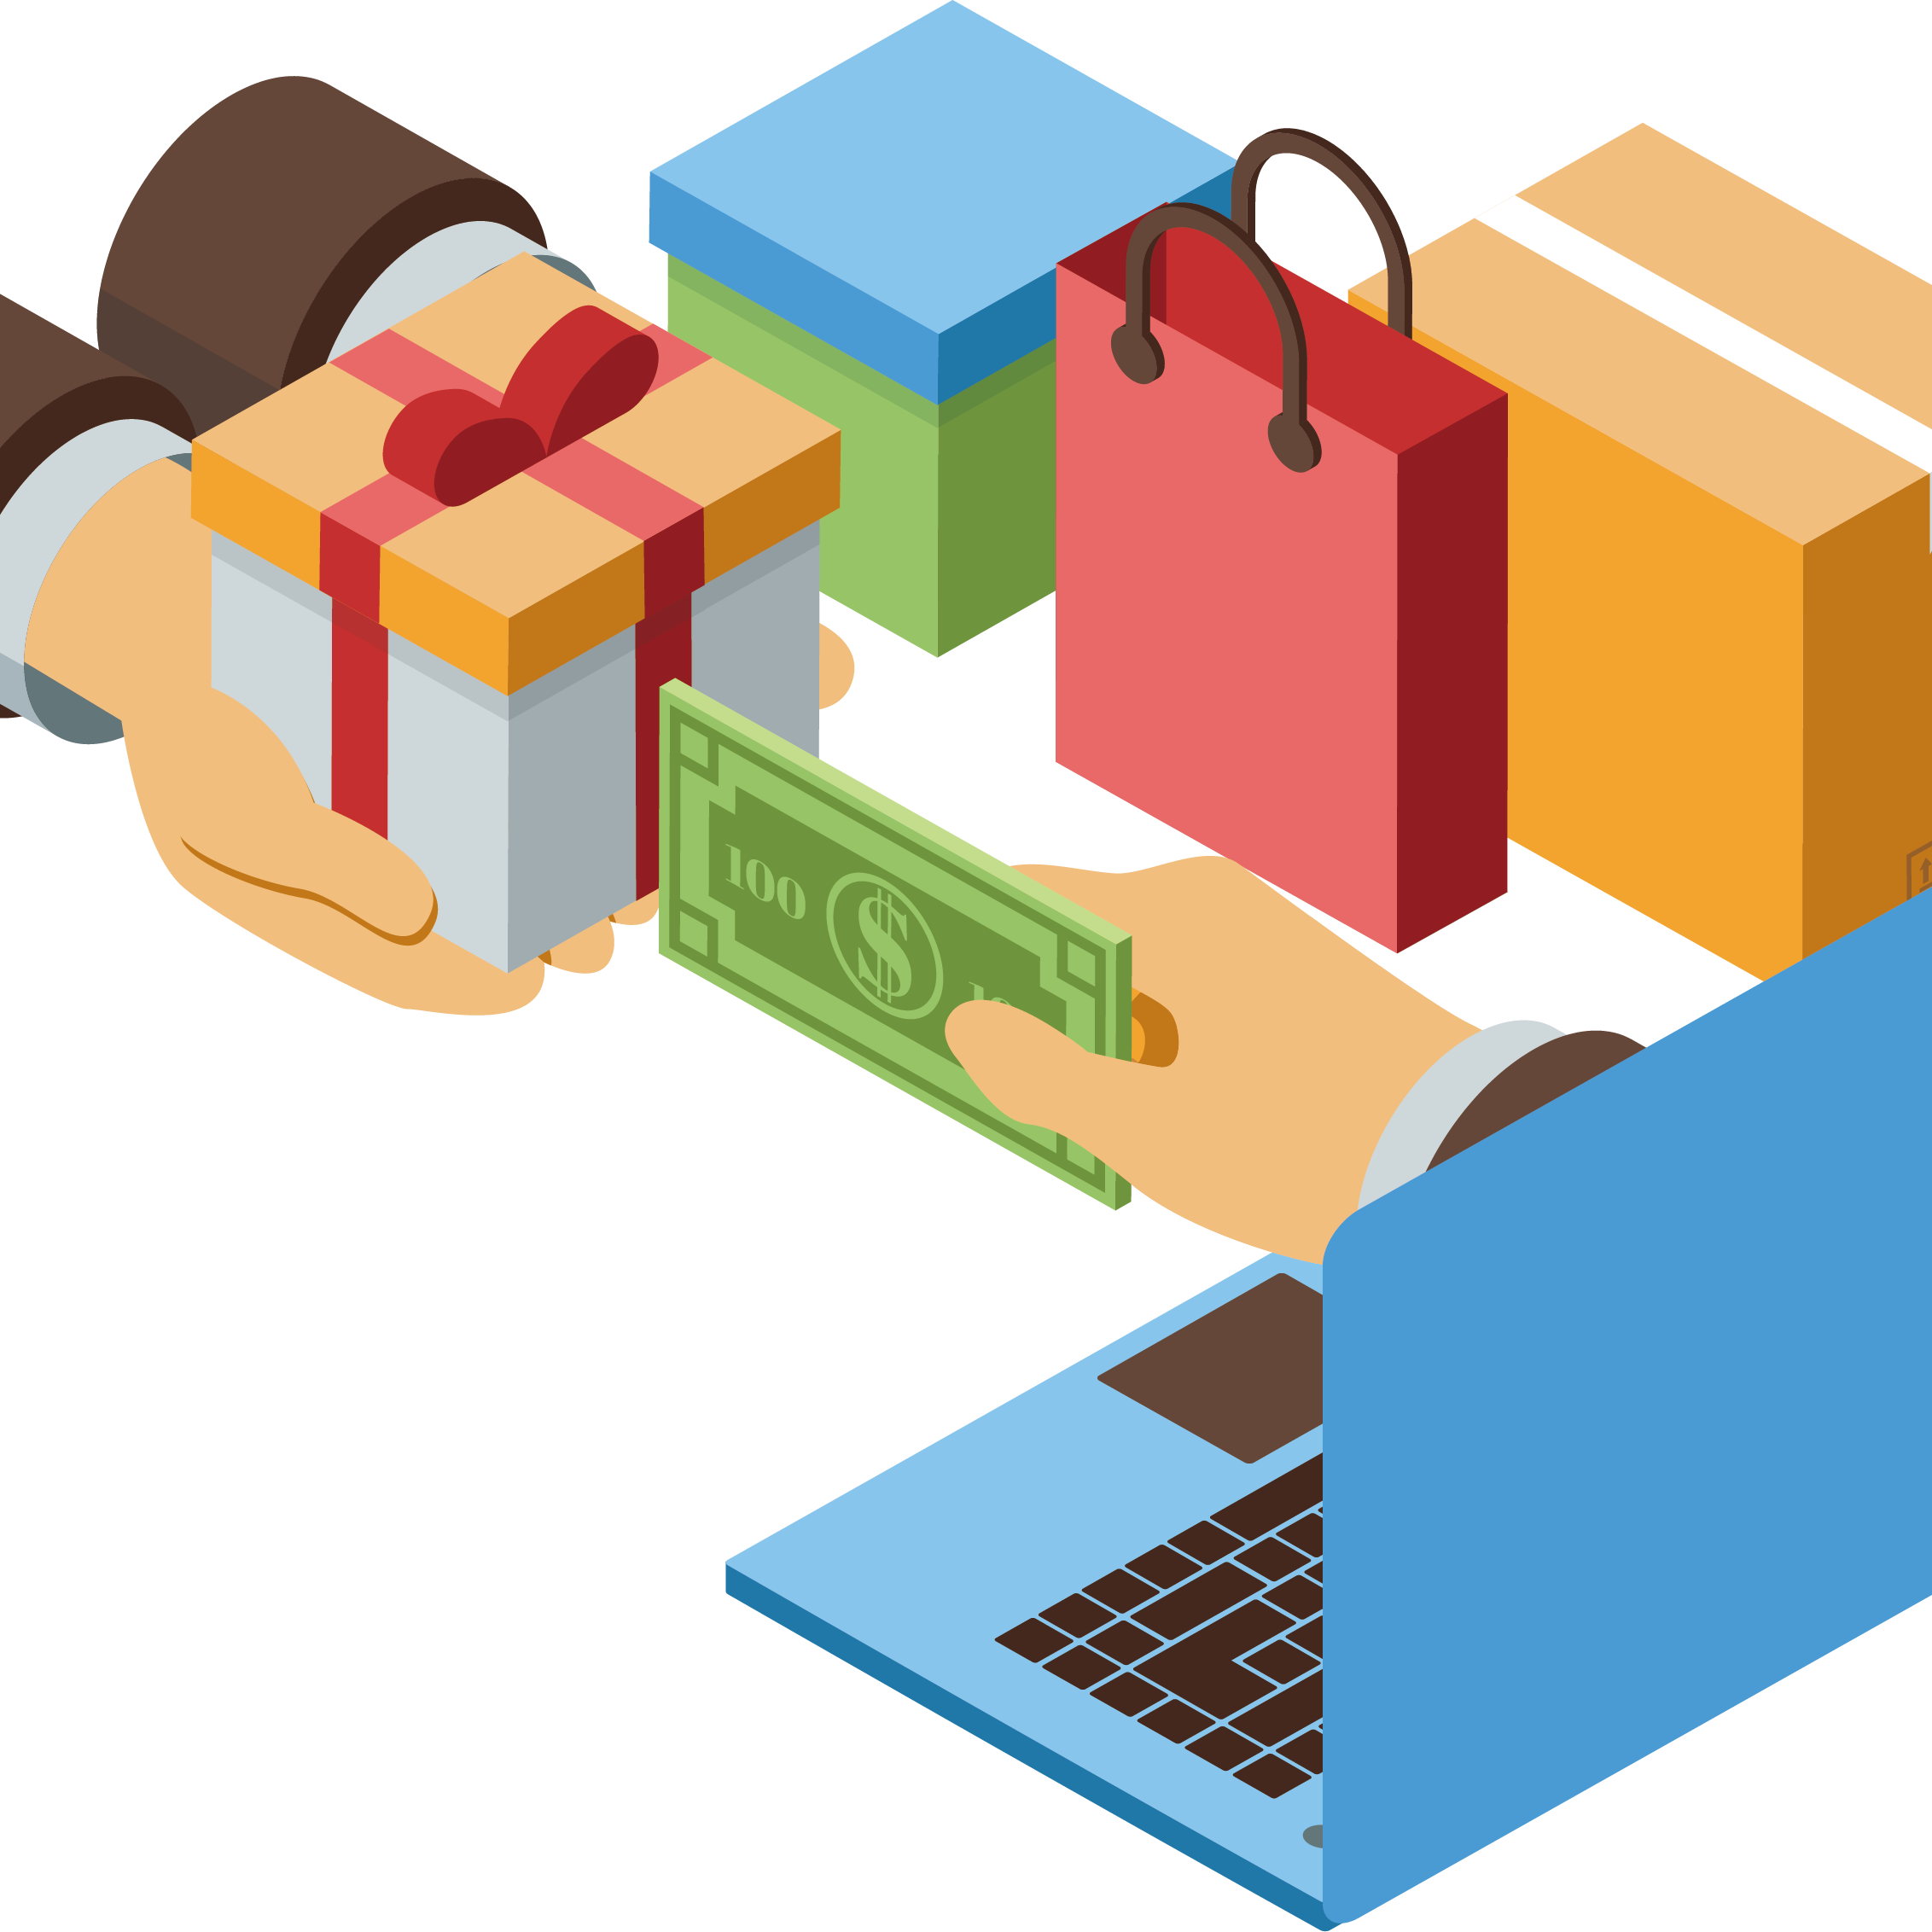

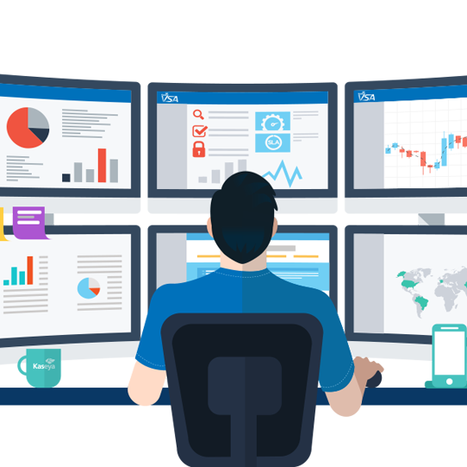
Make A transaction
Manage profile data
Advertise product data
This function is used by customers and UMKM partners for make buying and selling products. This feature delivers functionality for the user to be able to perform ordering products and services.
Functions used by customers, UMKM partners and admin to make changes to information on profile data.
Functions used by UMKM partners to perform changes in information on products and services offered on systems such as view, add, edit and delete product and service data.

Slide 6
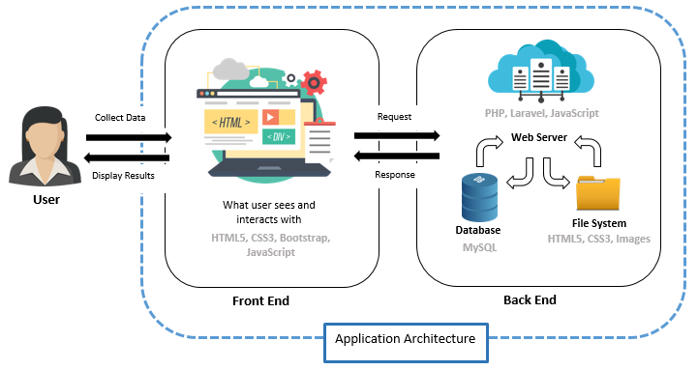
MVC CONCEPT

Slide 7
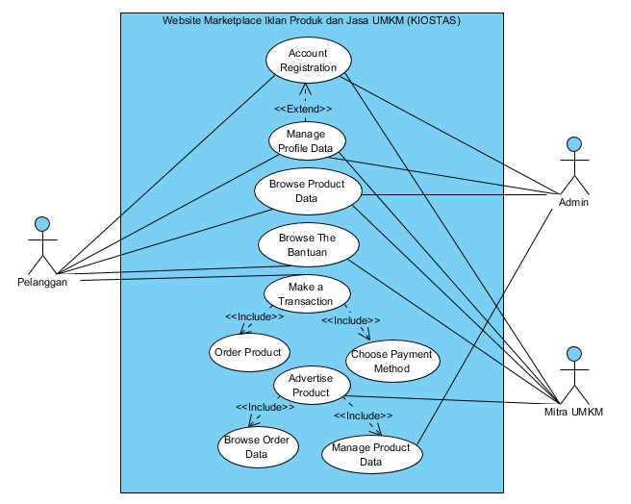
USE CASE DIAGRAM

Slide 8
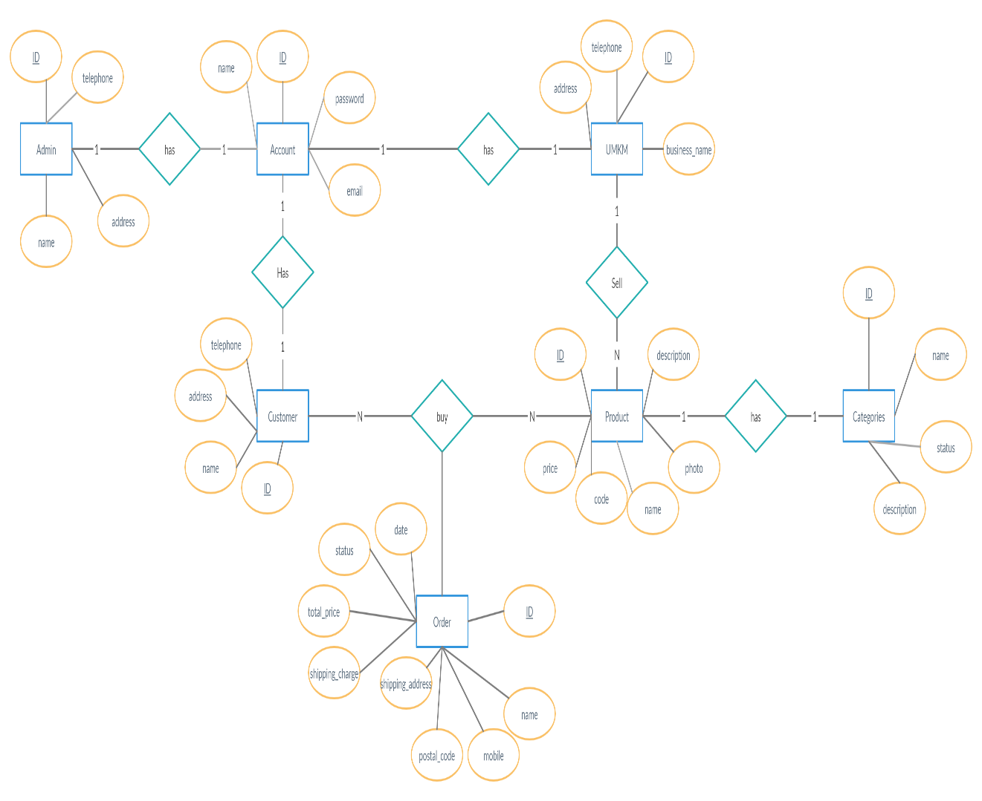
E-RDIAGRAM

Slide 9

Thank You!

